Slide 1
Fall Career Week at IUPUI:
Collaborating Campus-wide to Connect Students, Employers, and Alumni
Kathleen Hursh
Associate Director of Career Development
School of Public and Environmental Affairs
Jennifer Schott
Director of Career Planning
Academic and Career Development
University College

Slide 2
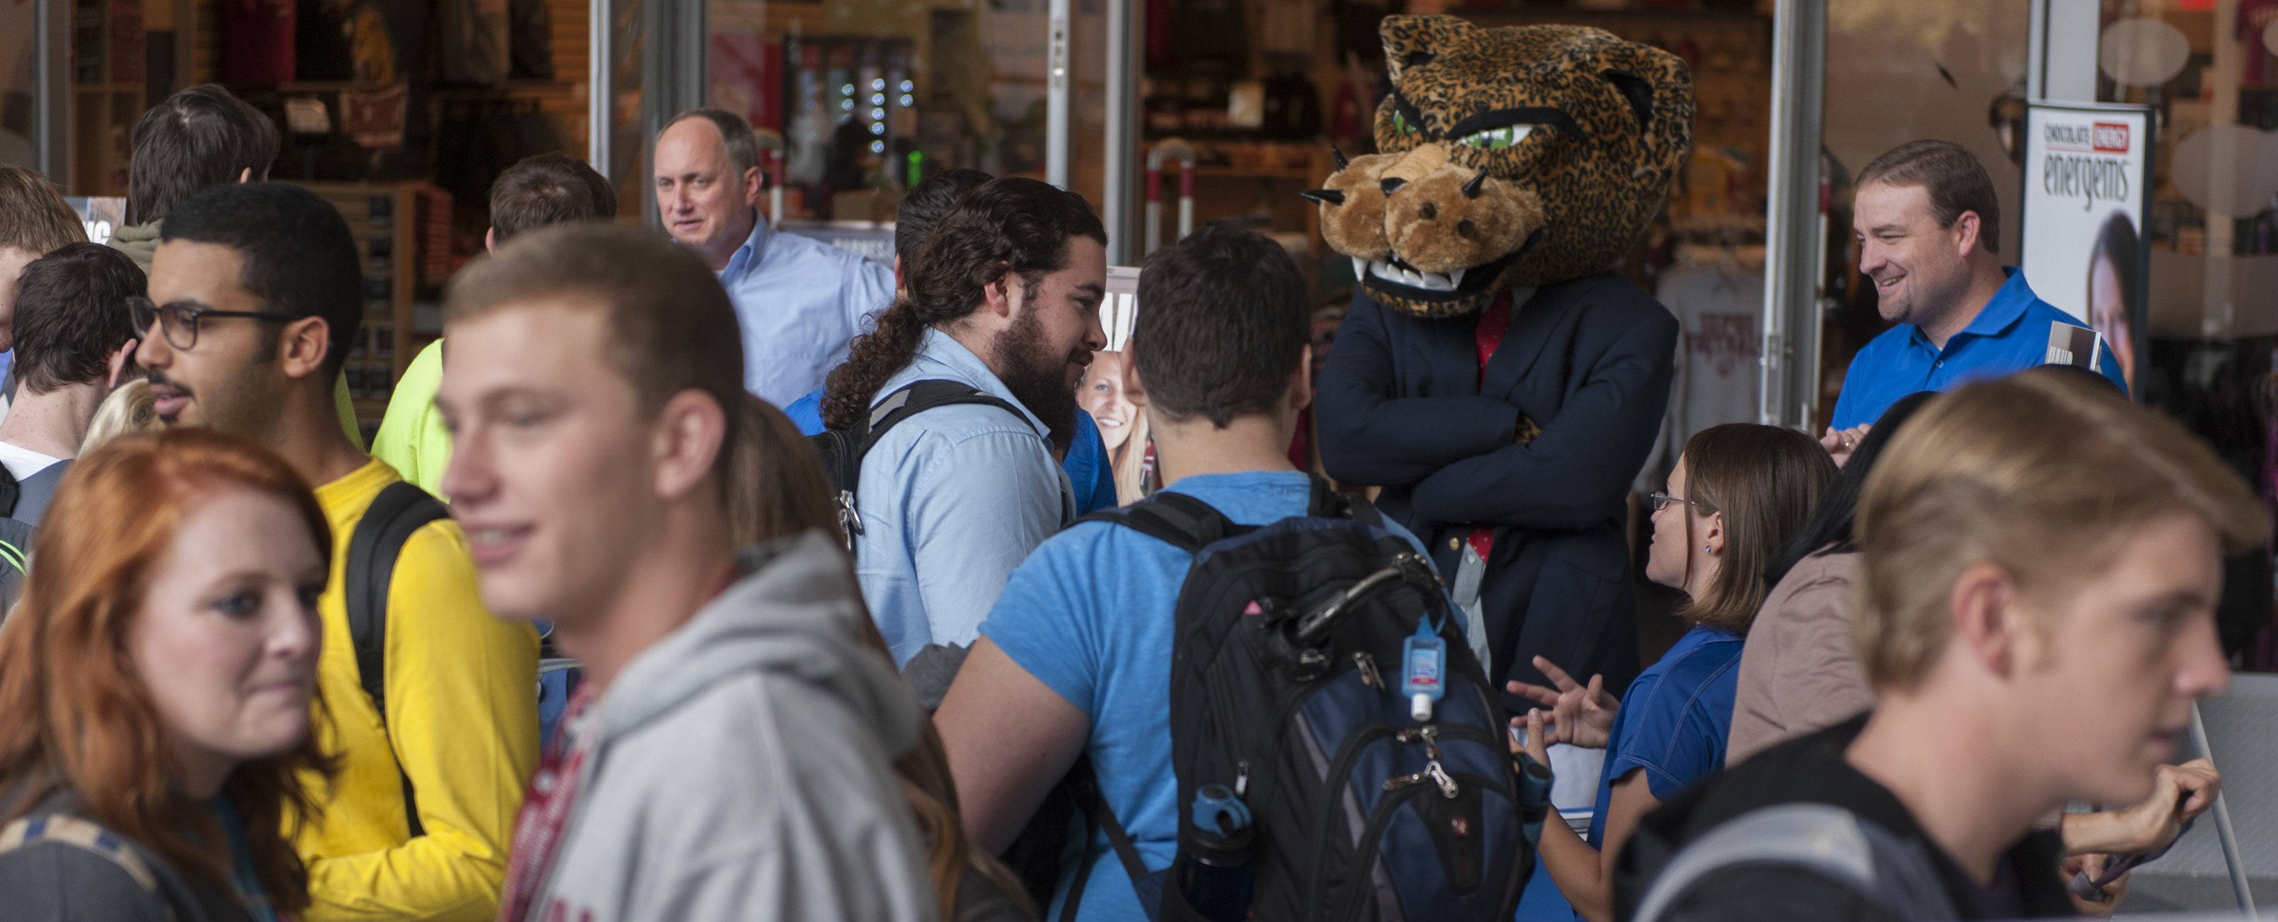
What is Fall Career Week (FCW)?
A week of career-related events for all students to learn about majors, careers, job searching, and more from staff, faculty, peers, alumni, and employers.

Slide 3
Why Did We Develop FCW?
To engage students at all levels of career development to facilitate informed decision-making about majors and careers.

Slide 4
Goals of FCW
Increase student awareness and understanding of major and career options
Assist students in developing professional skills
Facilitate connections for students, employers, and alumni
To raise awareness of the importance of campus inclusion in career development and planning

Slide 5
Development and Implementation
When
First Fall Career Week - 2009
Who
Career Services Council (CSC)
FCW Committee
Staff, faculty, peers, employers, alumni
How
Sponsored by CSC
LOTS of planning and coordinating by all
Where
Campus Center and other locations

Slide 6
FCW Participation

Slide 7
Pair and Share
What is your goal for implementing or improving a career program on your campus?

Slide 8
Collaborative Partnerships and Connections
Career Services Council (CSC)
Distributed network of career services
FCW Committee
Schools/Programs
Staff
Academic and Career Advisors
Faculty
Employers/Alumni
Communications Team

Slide 9
Value of Collaborative Partnerships
Campus Career Staff has developed new and valuable internal partners
Faculty engagement has been taken to a new level
Scope of Community Partnerships has increased

Slide 10
New Connections Students and Employers
Students exposed to new and diverse aspects of career opportunities
Employers expand their outreach – increase applicant pool
Students empowered to build networks that support their internship and job search

Slide 11
Faculty Engagement
New concentration of partnership opportunities
Ability to leverage staff and faculty relationships
Expand expectations for engagement

Slide 12
SPEA Faculty

Slide 13
Alumni Engagement
Creates stronger more intentional
Alumni ties
Engage Alumni in productive manner

Slide 14
Pair and Share
Identify opportunities to create positive and collaborative partnerships on your campus.

Slide 15
Engagement and Promotion

Slide 16
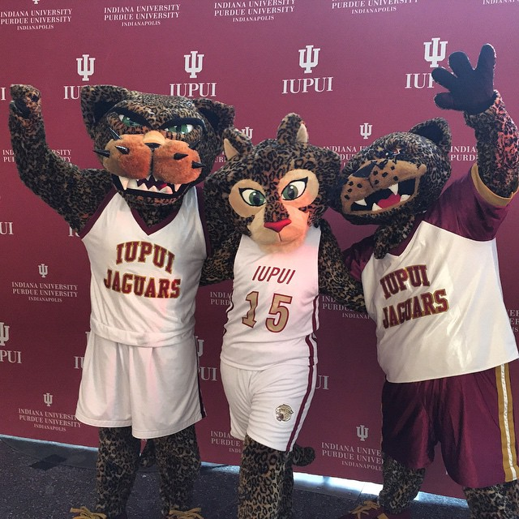
FCW Schedule and Outreach
Paper and Online schedule
Posters/banners/table tents
Social Media/website/digital signage/emails
In-person promos
Mascots
Cheerleaders
OTEAM
Regatta
Promo Tables
Classroom promos

Slide 17
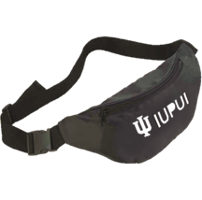
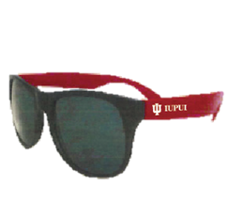
Giveaways and Promos
T-shirts
Fanny packs
Sunglasses
Headbands
Color-changing cups
Classroom Competition
Classroom Assignment
T-Shirt Competition

Slide 18
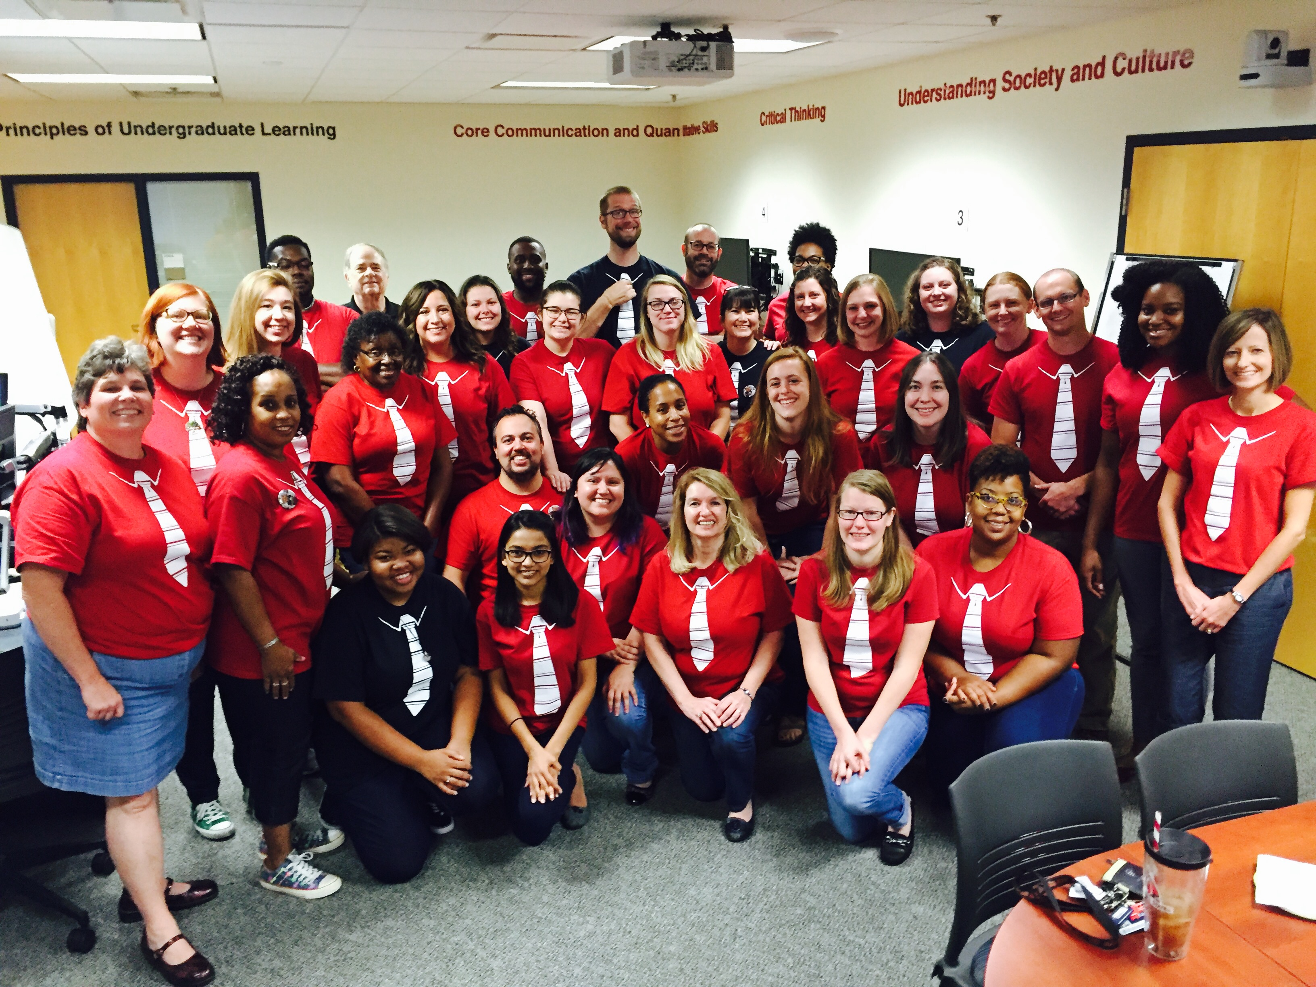

Slide 19
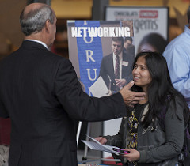

Slide 20
Professional Image Project

Slide 21
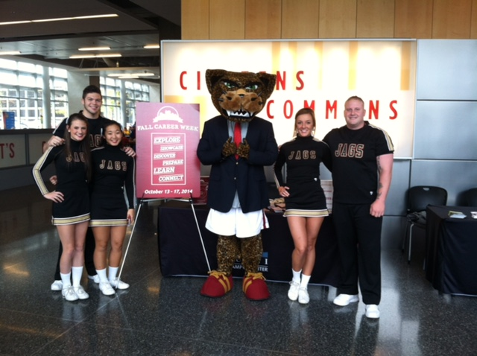

Slide 22
Pair and Share
What ideas do you have for engaging your campus and promoting your career program?

Slide 23
Future Goals
FCW will continue to evolve to meet campus and workforce expectations
Increase attendance and scope of activities
More intentional collaboration with
Student Affairs

Slide 24
Contact Us
Kathleen Hursh, hurshk@iupui.edu
Associate Director of Career Development
School of Public and Environmental Affairs
Jennifer Schott, jaschott@iupui.edu
Director of Career Planning
Academic and Career Development

